Slide 1
DSE ZG523 Introduction to Data Science
Lecture - 10
Sumita Narang

Slide 2
Objectives
Time Series Data Definition & Examples
How to store Time Series Data
How to estimate missing values in time series data
Data Preprocessing for Time Series Data
Finding Correlation in Time series data
Finding patterns in time series data
Measure of Similarity in time series data
Data Visualization for time Series Data
Time Series Data Modelling Techniques

Slide 3
Definition & Characteristics
Time Series Data

Slide 4
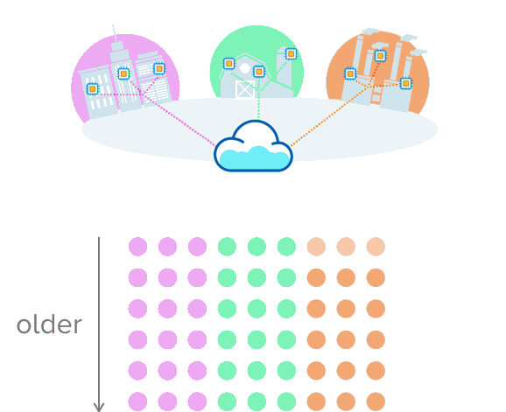
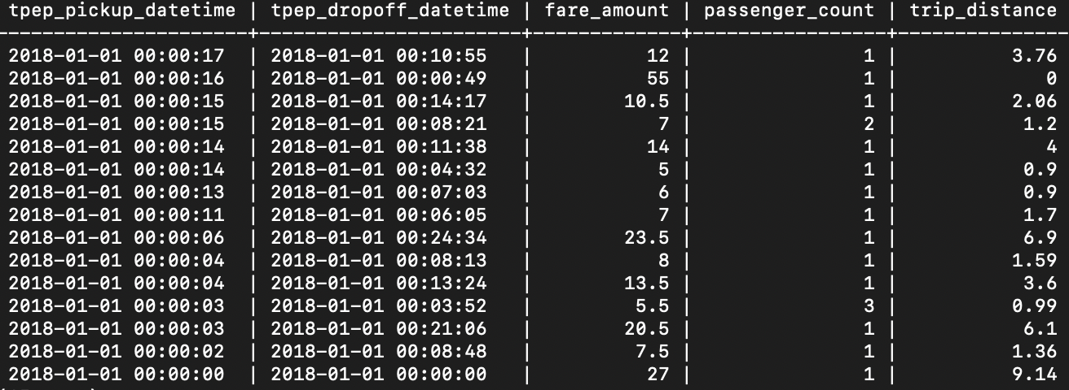
Time Series Data
Time Series Data Time series data is a special type of sequential data in which each record is a time series, i.e., a series of measurements taken over time.
Others may think of a series of numeric values, each paired with a timestamp, defined by a name and a set of labeled dimensions (or “tags”). This is perhaps one way to model time-series data, but not a definition of the data itself.
Univariate Time Series – One variable, changing with time
Sensors collecting data over time from different sources
Data from New York, showing taxicab rides for the first few seconds of 2018

Slide 5
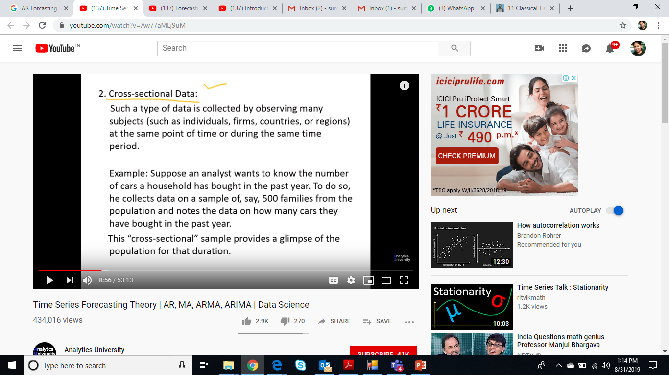
Cross Sectional Data

Slide 6
Time Series Data Examples
A financial data set might contain objects that are time series of the daily prices of various stocks.
Time series of the average monthly temperature for Minneapolis during the years 1982 to 1994
Self-driving cars continuously collect data about how their local environment is changing around them.
Autonomous trading algorithms continuously collect data on how the markets are changing.
Our smart homes monitor what’s going on inside of them to regulate temperature, identify intruders, and respond to our beck-and-call (“Alexa, play some relaxing music”).
Our retail industry monitors how their assets are moving with such precision and efficiency that cheap same-day delivery is a luxury that many of us take for granted.
The NYPD tracks its vehicles to allow us to hold them more accountable (e.g., for analyzing 911 response times).
There are many other kinds of time-series data. To name a few: DevOps monitoring data, mobile/web application event streams, industrial machine data, scientific measurements.

Slide 7
Data Science Use Cases – Time Series Data
Monitoring software systems: Virtual machines, containers, services, applications
Monitoring physical systems: Equipment, machinery, connected devices, the environment, our homes, our bodies
Asset tracking applications: Vehicles, trucks, physical containers, pallets
Financial trading systems: Classic securities, newer cryptocurrencies
Eventing applications: Tracking user/customer interaction data
Business intelligence tools: Tracking key metrics and the overall health of the business(and more)

Slide 8
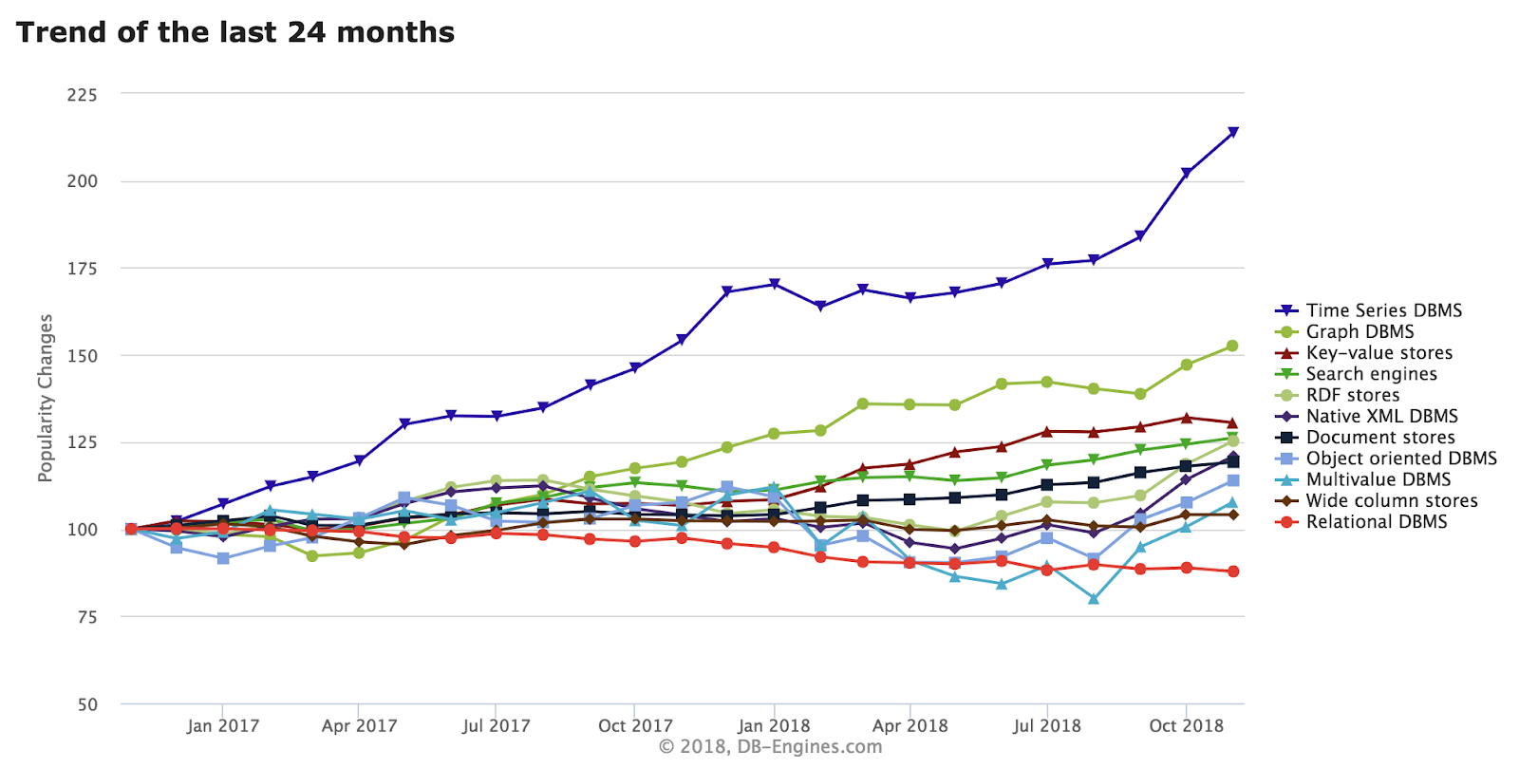
How time series Data becoming popular

Slide 9
Characteristics of Time Series Data 1/
The data that arrives is almost always recorded as a new entry
The data typically arrives in time order
Time is a primary axis (time-intervals can be either regular or irregular)
In other words, time-series data workloads are generally “append-only.” While they may need to correct erroneous data after the fact, or handle delayed or out-of-order data, these are exceptions, not the norm.
Simply put: time-series datasets track changes to the overall system as INSERTs, not UPDATEs.
This practice of recording each and every change to the system as a new, different row is what makes time-series data so powerful. It allows us to measure change: analyze how something changed in the past, monitor how something is changing in the present, predict how it may change in the future.
Unlike the analyses of random samples of observations that are discussed in the context of most other statistics, the analysis of time series is based on the assumption that successive values in the data file represent consecutive measurements taken at equally spaced time intervals.

Slide 10
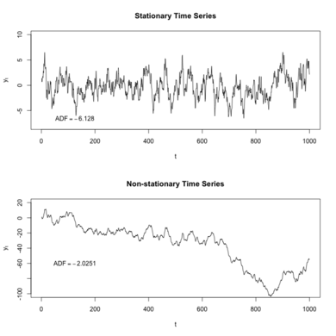
Characteristics of Time Series Data 2/
Stationarity in TS Data
Stationarity means that the statistical properties of a process generating a time series do not change over time. It does not mean that the series does not change over time, just that the way it changes does not itself change over time. The algebraic equivalent is thus a linear function, perhaps, and not a constant one; the value of a linear function changes as 𝒙 grows, but the way it changes remains constant — it has a constant slope; one value that captures that rate of change.
Stationary processes are easier to analyze.
https://www.youtube.com/watch?v=xbzJp78kOiI
Joint Probability Distribution of series does not change over time i.e. mean and variance remain constant over time.

Slide 11
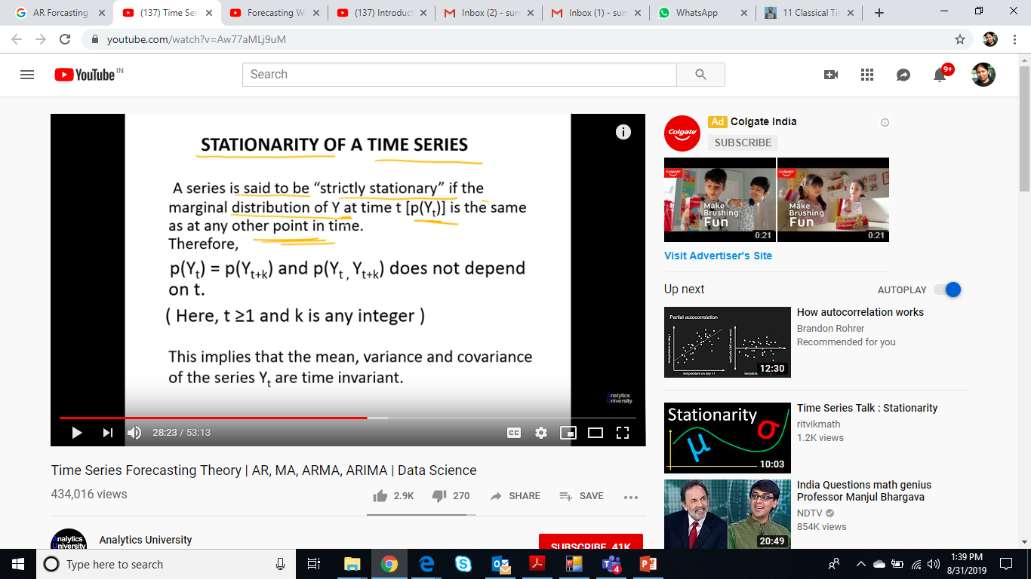
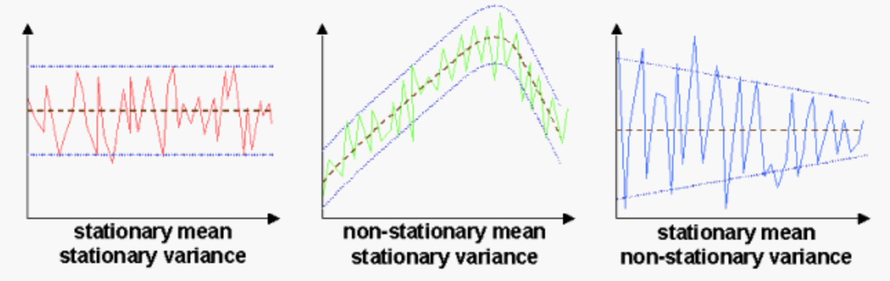
Stationarity Measures

Slide 12
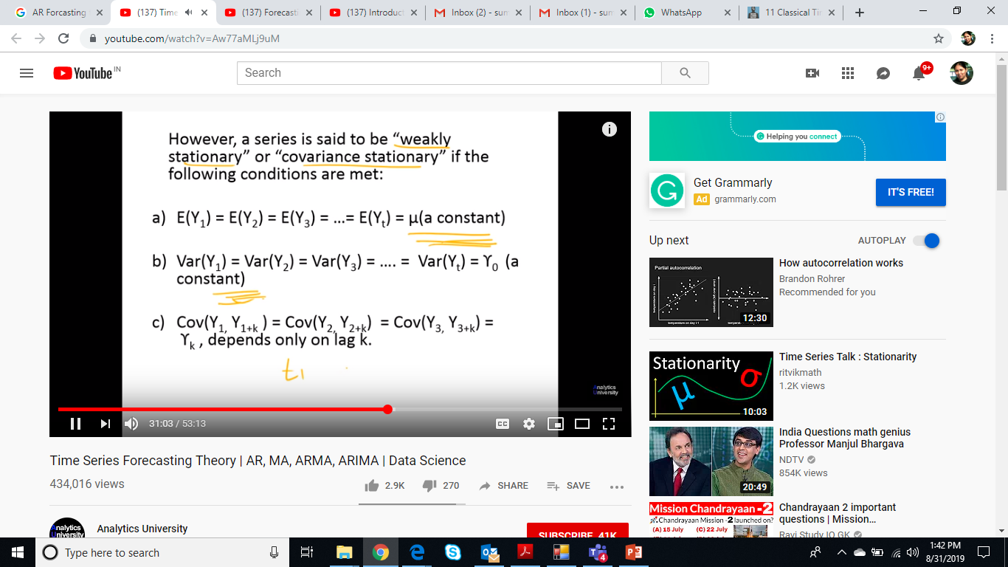
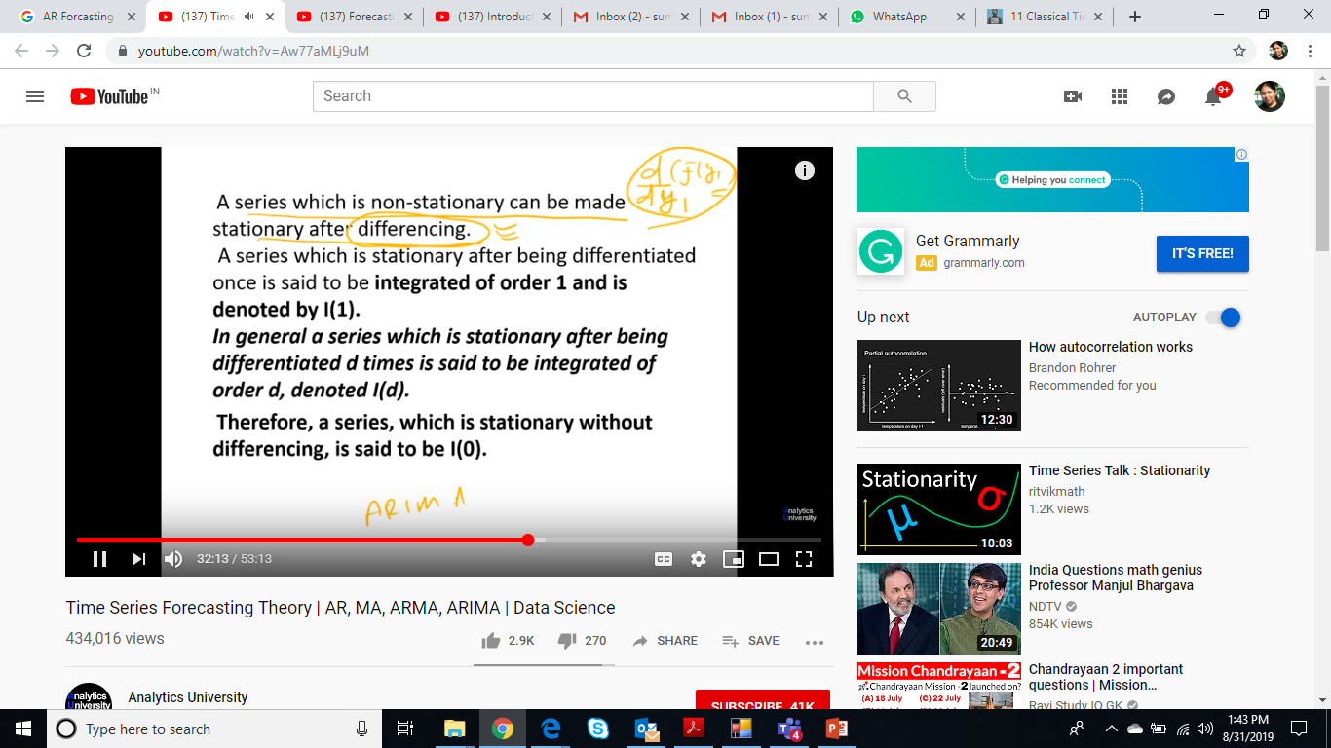
Stationarity Measures

Slide 13
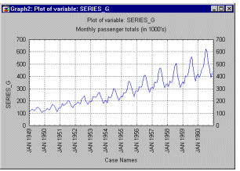
Characteristics of Time Series Data 3/
Time Series Components
A useful abstraction for selecting forecasting methods is to break a time series down into systematic and unsystematic components.
Systematic: Components of the time series that have consistency or recurrence and can be described and modeled.
Non-Systematic: Components of the time series that cannot be directly modeled.
A given time series is thought to consist of three systematic components including level, trend, seasonality, cyclical, and one non-systematic component called noise.
These components are defined as follows:
Level: The average value in the series.
Trend: The increasing or decreasing value in the series. Trend represents a general systematic linear or (most often) nonlinear component that changes over time and does not repeat or at least does not repeat within the time range captured by our data (e.g., a plateau followed by a period of exponential growth).
Seasonality: The repeating short-term cycle in the series. Seasonality repeats itself in systematic intervals over time. Trend and Seasonality time series components may coexist in real-life data. For example, sales of a company can rapidly grow over years but they still follow consistent seasonal patterns (e.g., as much as 25% of yearly sales each year are made in December, whereas only 4% in August).
Cyclical: The repeated pattern that appears in TS Data over long time periods
Noise: The random variation in the series.
https://www.youtube.com/watch?v=IAFxMLmR-so
Additive Seasonality – constant magnitude
Multiplicative Seasonality –increasing magnitude

Slide 14
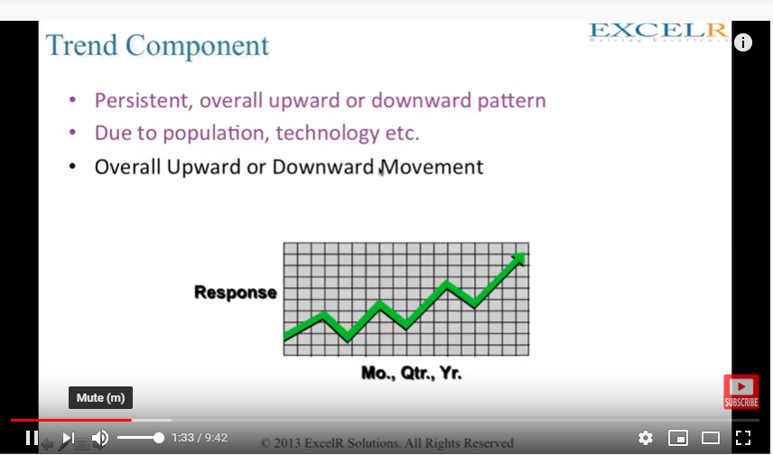
Trend component

Slide 15
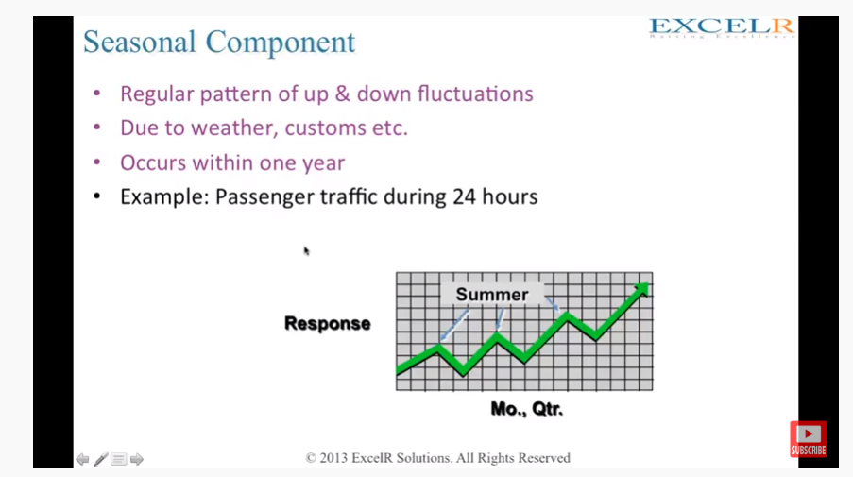
Seasonal component

Slide 16
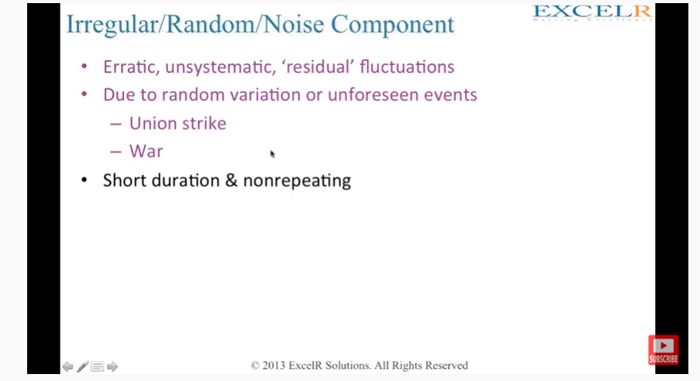
Noise Component

Slide 17
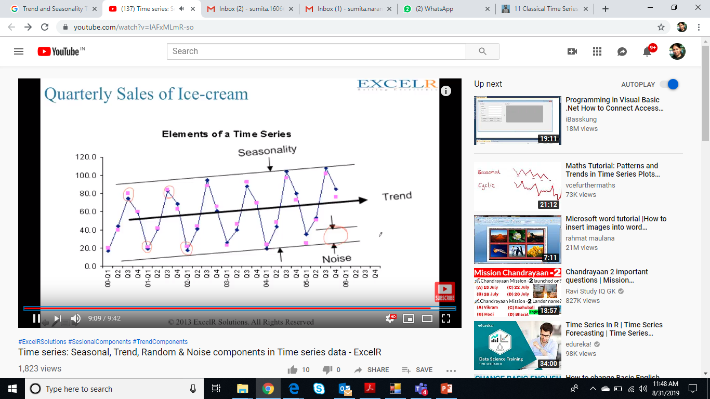

Slide 18
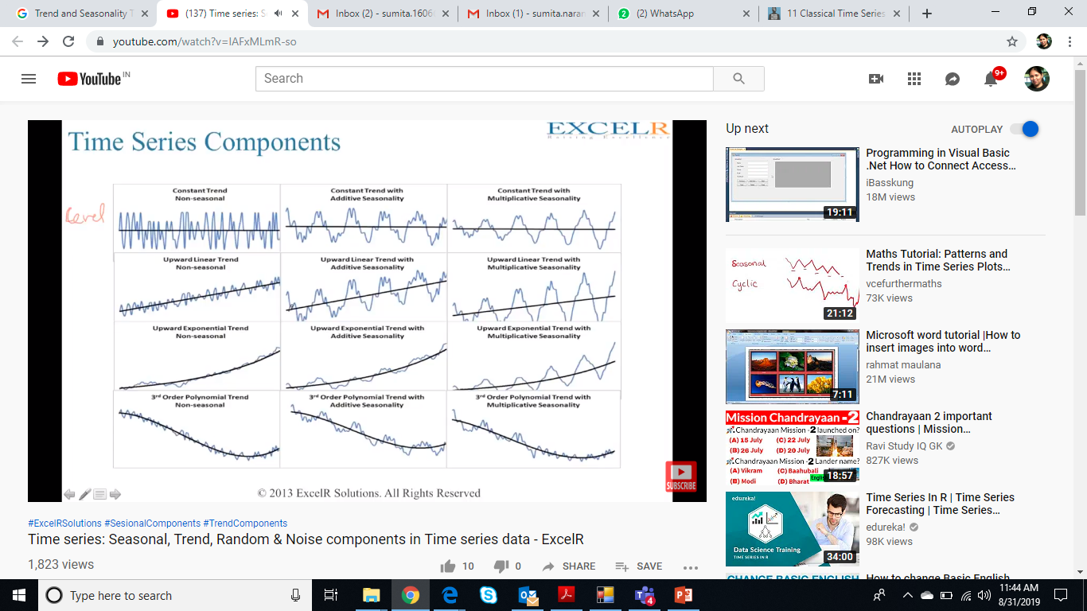

Slide 19
Storage, Pre-processing
Time Series Data

Slide 20
How to store Time Series Data
Why can’t I just use a “normal” (i.e., non-time-series) database?
The truth is that you can, and some people do. Yet why are TSDBs the fastest growing category of databases today? Two reasons: (1) scale and (2) usability.
Scale: Time-series data accumulates very quickly. (For example, a single connected car will collect 4,000 GB of data per day.) And normal databases are not designed to handle that scale. Relational databases fare poorly with very large datasets; NoSQL databases fare better at scale, but can still be outperformed by a database fine-tuned for time-series data. In contrast, time-series databases (which can be based on relational or NoSQL databases) handle scale by introducing efficiencies that are only possible when you treat time as a first class citizen. These efficiencies result in performance improvements, including higher ingest rates, faster queries at scale (although some support more queries than others), and better data compression.
Usability: TSDBs also typically include functions and operations common to time-series data analysis such as data retention policies, continuous queries, flexible time aggregations, etc. Even if scale it not a concern at the moment (e.g., if you are just starting to collect data), these features can still provide a better user experience and make your life easier.
More about TSDBs -
https://www.influxdata.com/time-series-database/
https://www.datastax.com/dev/blog/advanced-time-series-data-modelling (ease to store offset, value)

Slide 21
Estimate Missing Values – time series data
Sometimes missing data can be reliably estimated.
For example, consider a time series that changes in a reasonably
smooth fashion, but has a few, widely scattered missing values. In such cases,
the missing values can be estimated (interpolated) bV using the remaining
values.
As another example, consider a data set that has many similar data points. In this situation, the attribute values of the points closest to the point with the missing value are often used to estimate the missing value.
If the attribute is continuous, then the average attribute value of the nearest neighbors is used;
if the attribute is categorical, then the most commonly occurring attribute value can be taken.
For a concrete illustration, consider precipitation measurements that are recorded by ground stations. For areas not containing a ground station, the precipitation can be estimated using values observed at nearby ground stations.

Slide 22
Identifying Patterns in TS Data
Data Visualization Techniques
Finding TS Data Components

Slide 23
Pattern Analysis in TS Data
There are two main goals of time series analysis:
identifying the nature of the phenomenon represented by the sequence of observations, and
forecasting (predicting future values of the time series variable).
Both of these goals require that the pattern of observed time series data is identified and more or less formally described. Once the pattern is established, we can interpret and integrate it with other data (i.e., use it in our theory of the investigated phenomenon, e.g., seasonal commodity prices).
Steps in Pattern analysis of TS Data
Time Series Data analysis via Plots, Data visualization techniques
Decompose time series data into 4 components – Level, Trend, Seasonality and Noise.
Measure of Stationarity in TS Data

Slide 24
Time Series Data visualization
https://www.youtube.com/watch?v=wCQa6phqhSw
Time Series Plot
Lag Plot
Autocorrelation Plot/ Correlogram

Slide 25
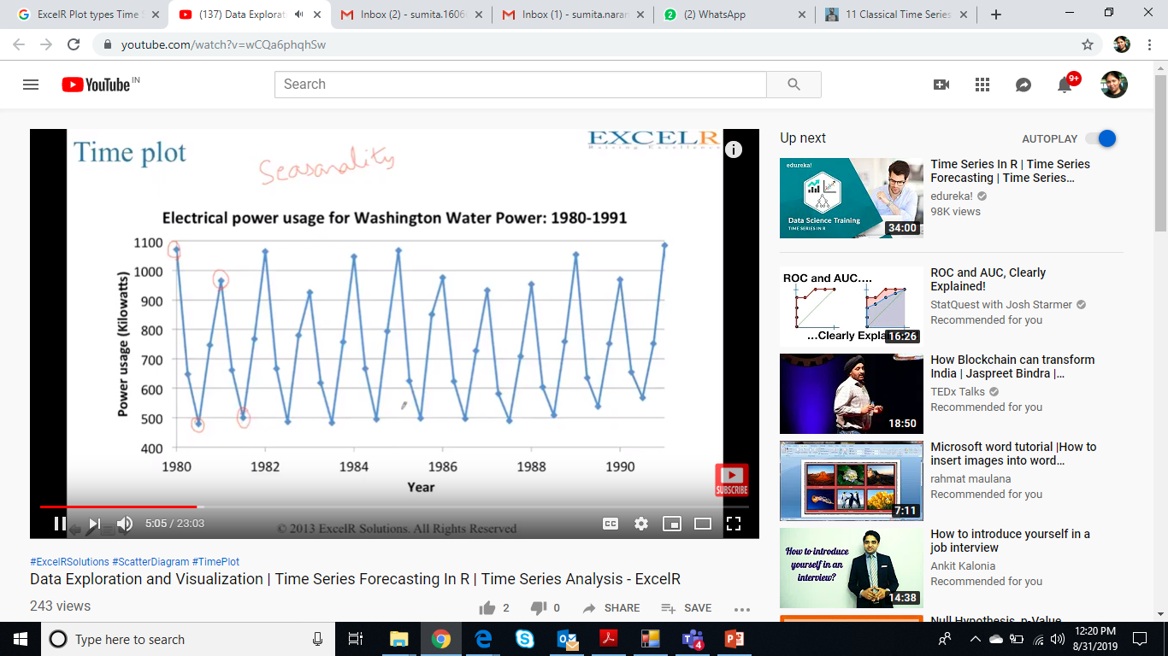

Slide 26
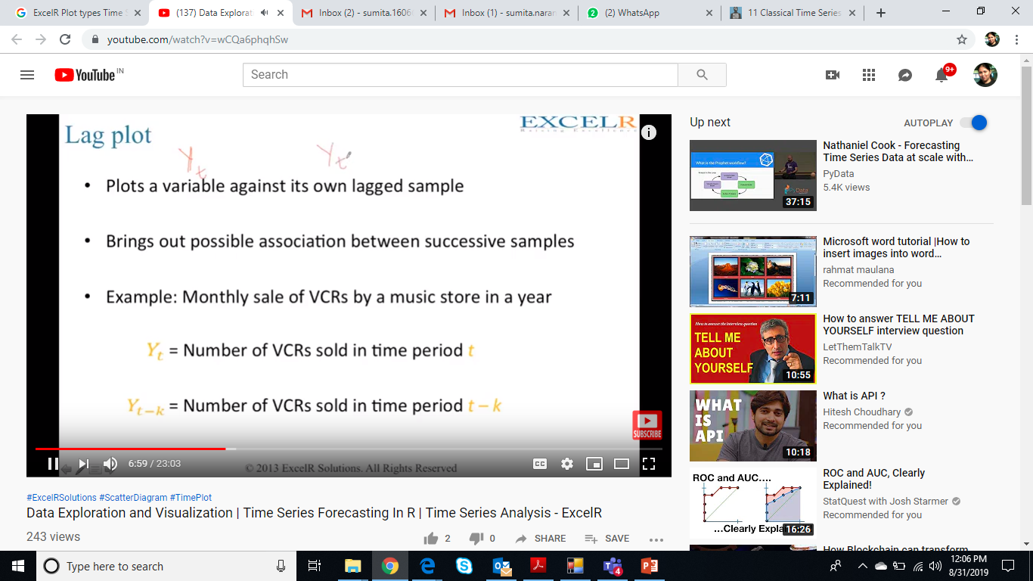
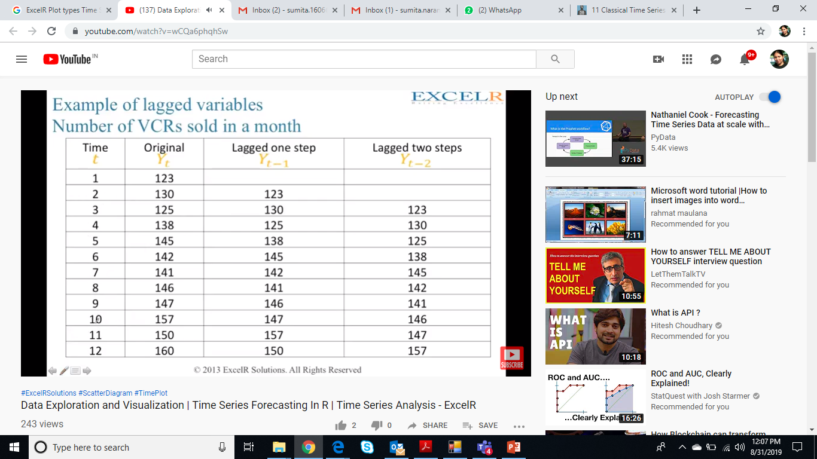

Slide 27
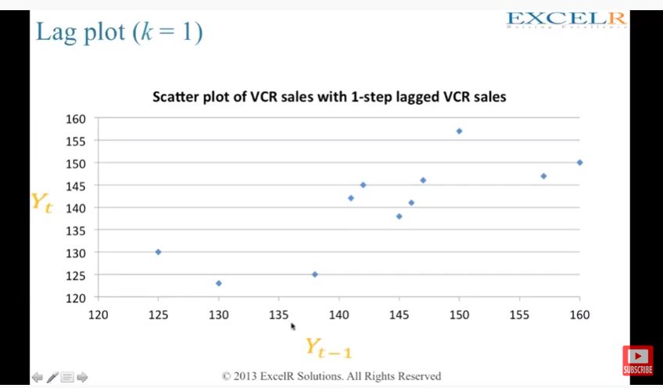

Slide 28
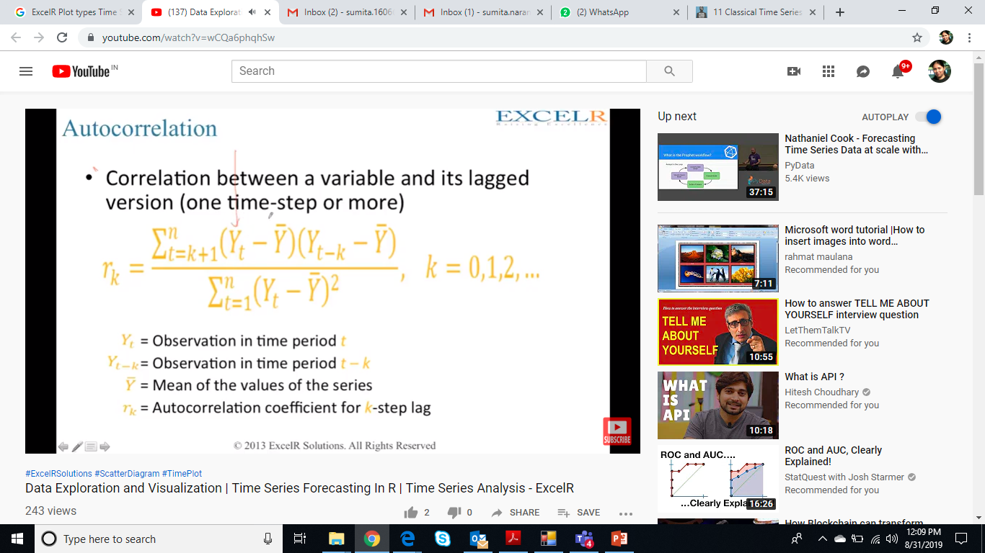
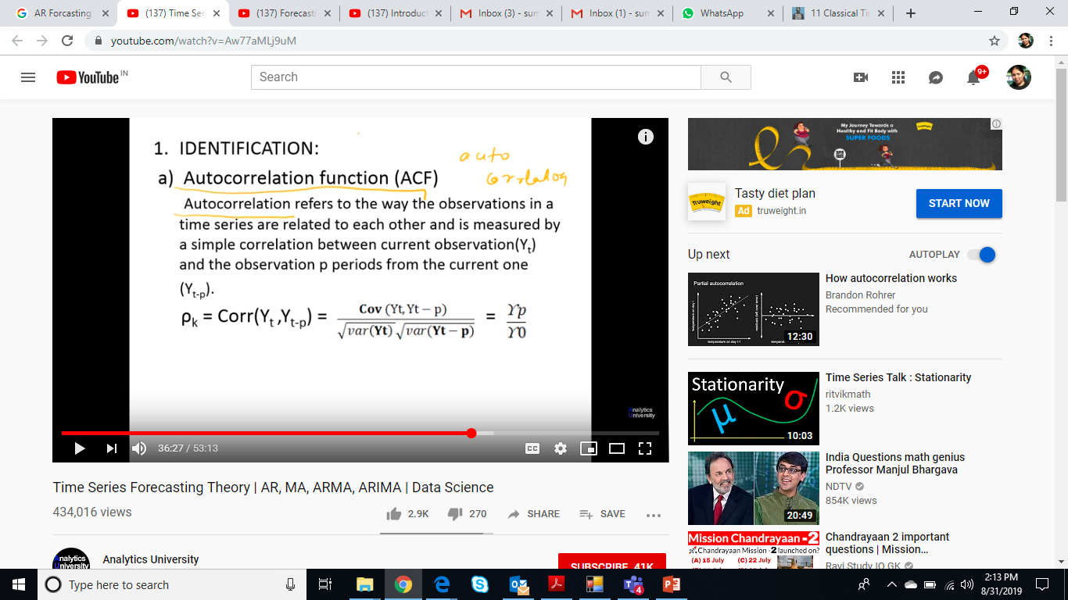

Slide 29
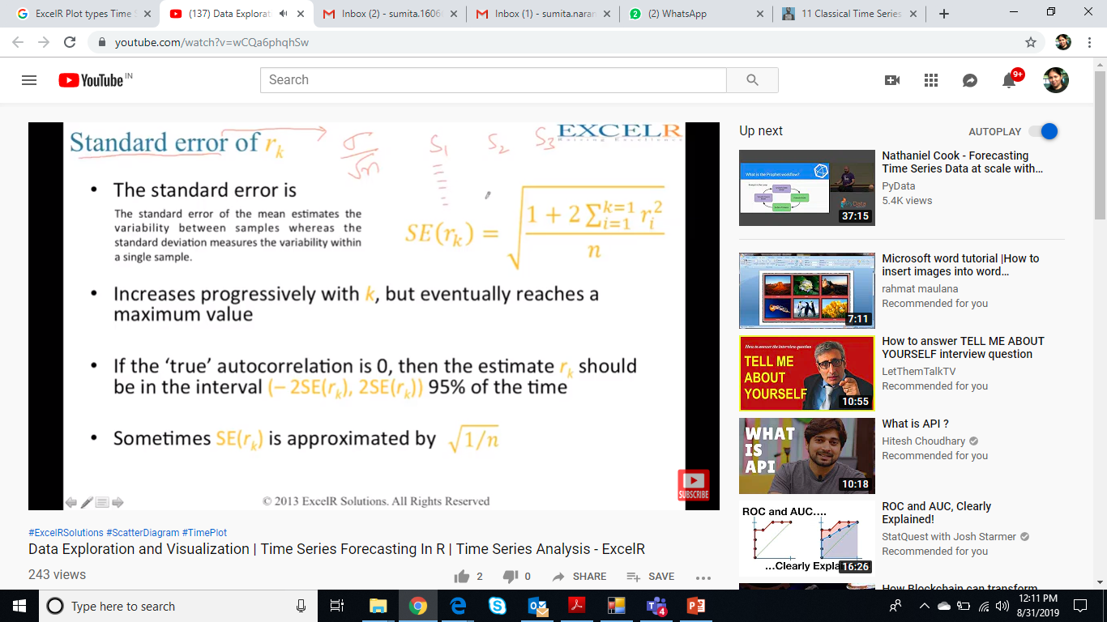

Slide 30
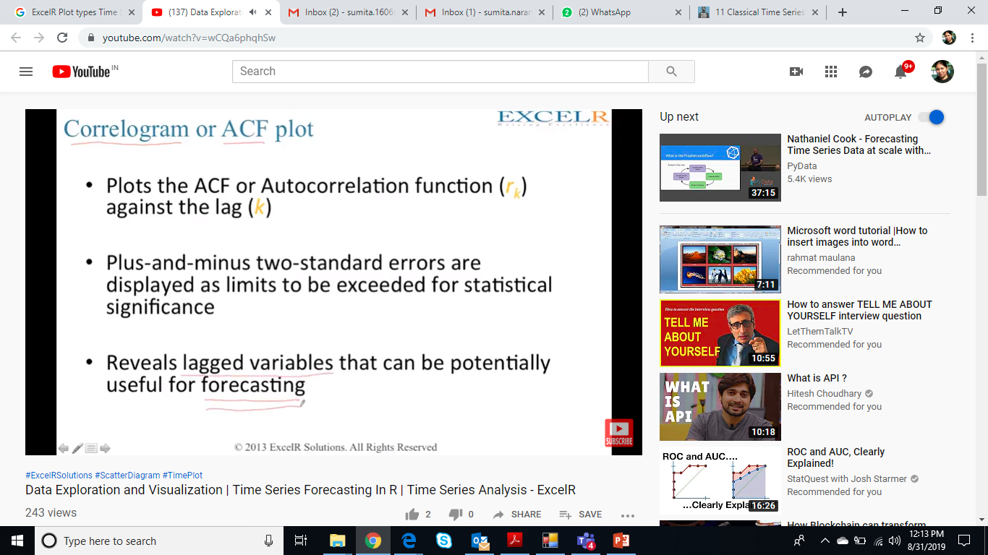
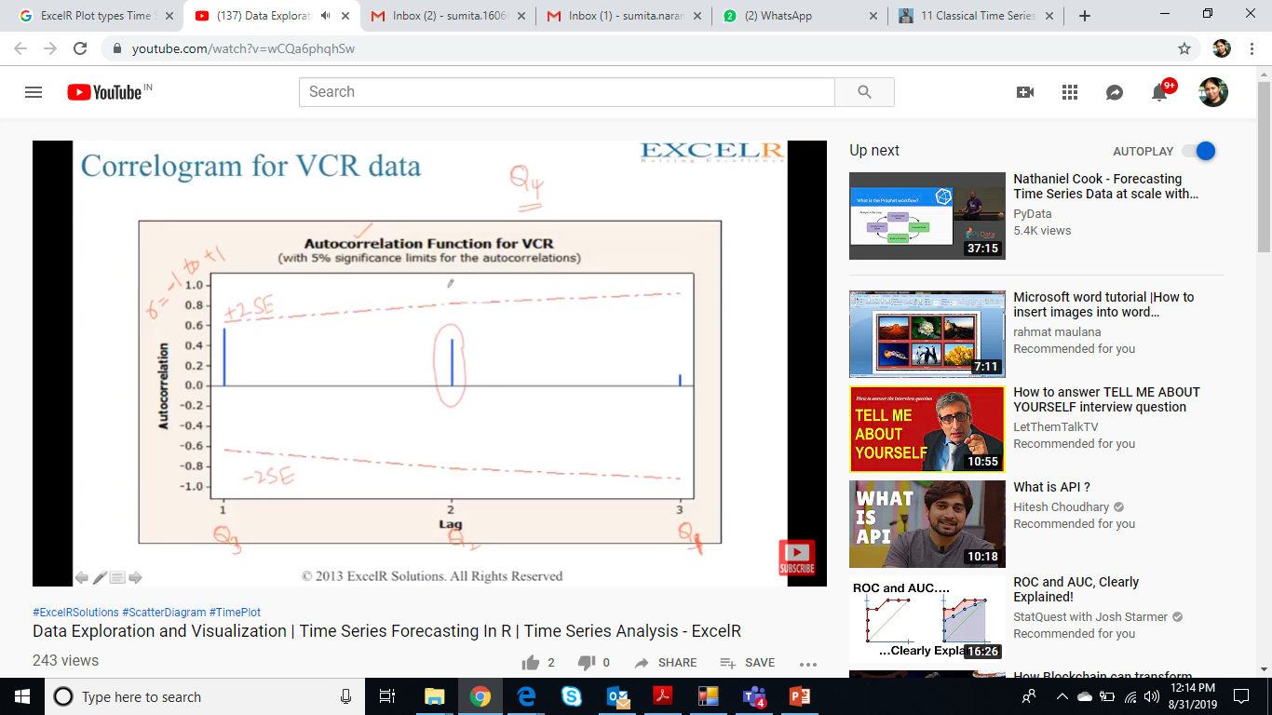

Slide 31


Slide 32
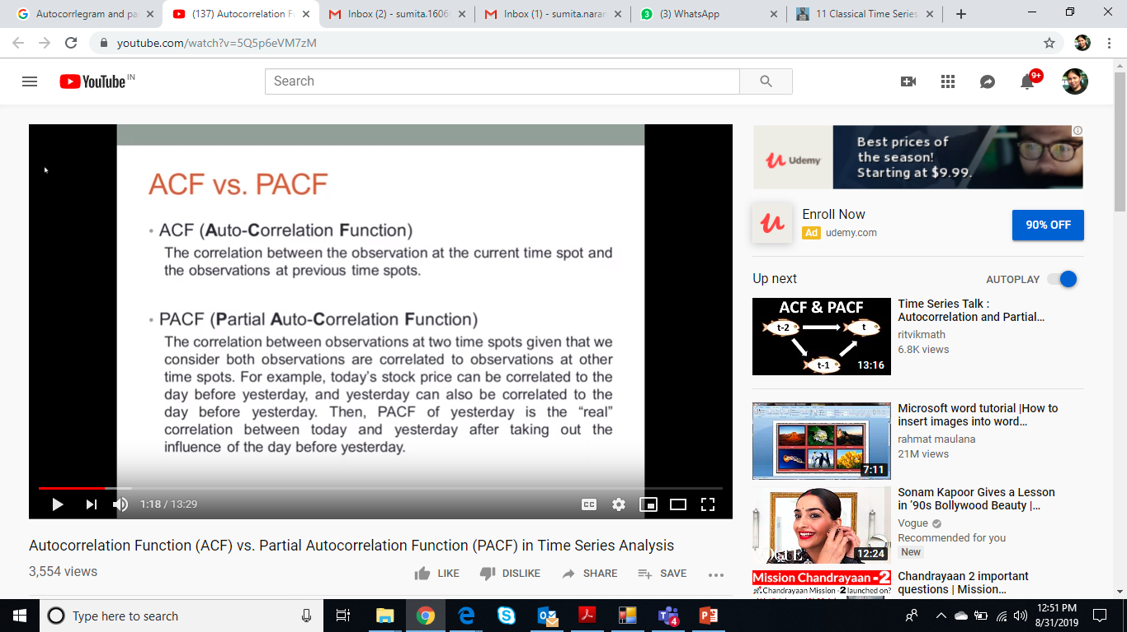
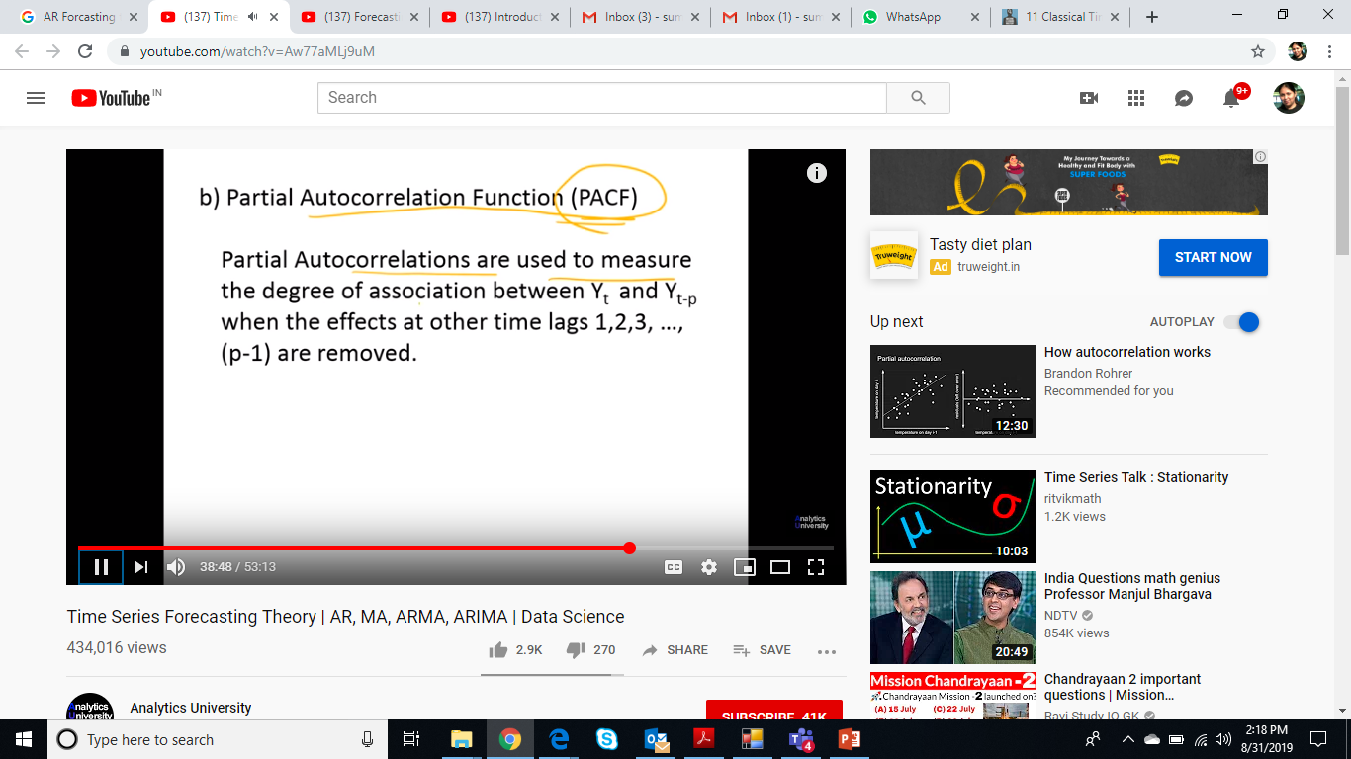
ACF vs PACF
https://www.youtube.com/watch?v=R-oWTWdS1Jg
https://www.youtube.com/watch?v=5Q5p6eVM7zM

Slide 33
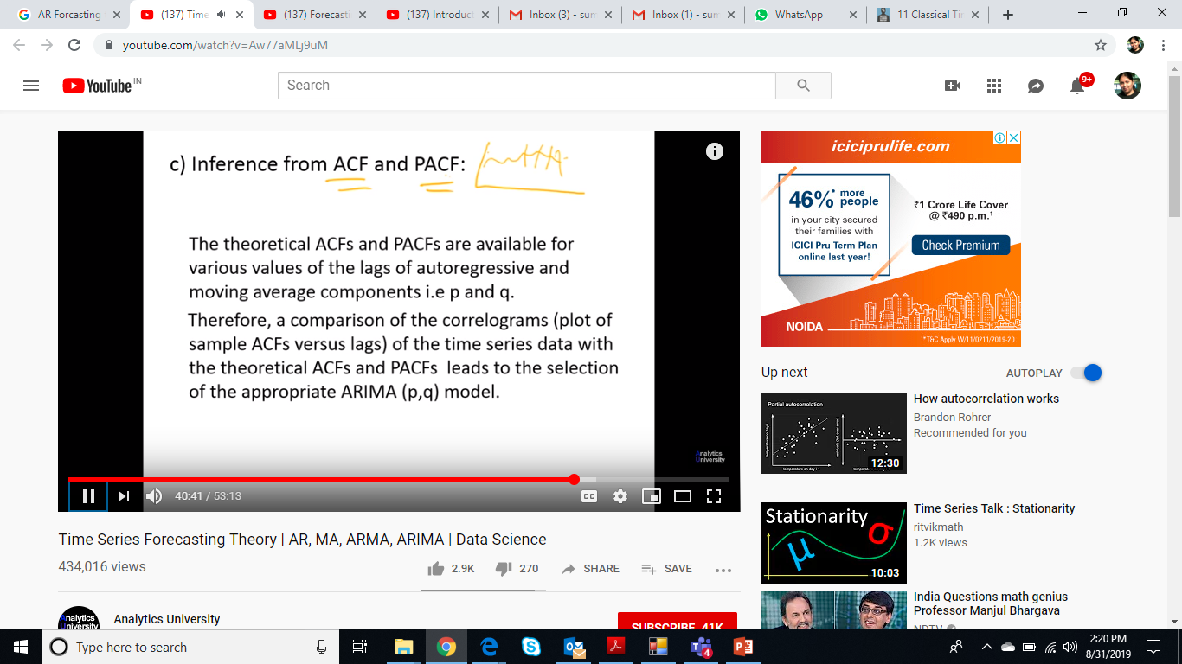

Slide 34
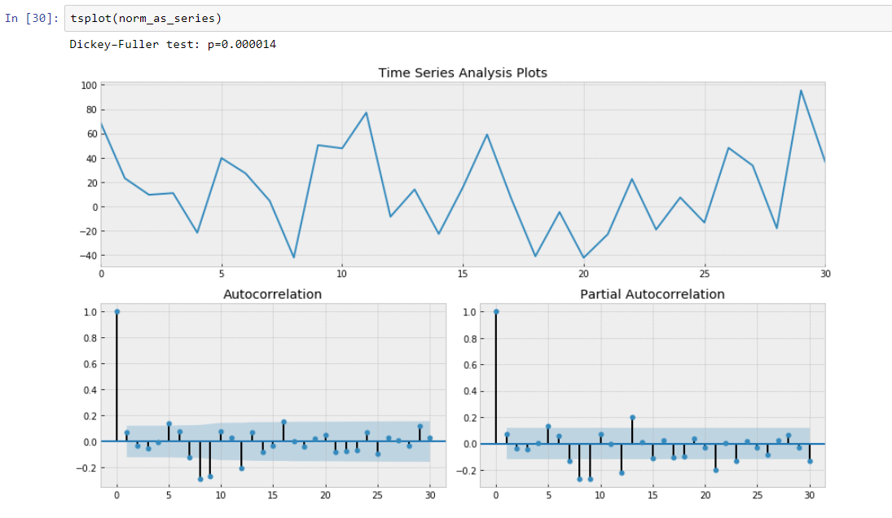
Time series of the average monthly temperature for Minneapolis during the years 1982 to 1994
Refer T2, Ch 3 (exercise -3.6, Q-13)

Slide 35
Trend Analysis in TS Data
There are no proven "automatic" techniques to identify trend components in the time series data; however, as long as the trend is monotonous (consistently increasing or decreasing) that part of data analysis is typically not very difficult. If the time series data contain considerable error, then the first step in the process of trend identification is smoothing.
Smoothing. Smoothing always involves some form of local averaging of data such that the nonsystematic components of individual observations cancel each other out.
The most common technique is moving average smoothing which replaces each element of the series by either the simple or weighted average of n surrounding elements, where n is the width of the smoothing "window“.
Medians can be used instead of means. The main advantage of median as compared to moving average smoothing is that its results are less biased by outliers (within the smoothing window). Thus, if there are outliers in the data (e.g., due to measurement errors), median smoothing typically produces smoother or at least more "reliable" curves than moving average based on the same window width. The main disadvantage of median smoothing is that in the absence of clear outliers it may produce more "jagged" curves than moving average and it does not allow for weighting.
In the relatively less common cases (in time series data), when the measurement error is very large, the distance weighted least squares smoothing or negative exponentially weighted smoothing techniques can be used. All those methods will filter out the noise and convert the data into a smooth curve that is relatively unbiased by outliers (see the respective sections on each of those methods for more details). Series with relatively few and systematically distributed points can be smoothed with bicubic splines.
Fitting a function. Many monotonous time series data can be adequately approximated by a linear function; if there is a clear monotonous nonlinear component, the data first need to be transformed to remove the nonlinearity. Usually a logarithmic, exponential, or (less often) polynomial function can be used.

Slide 36
Seasonality analysis in TS Data 1/
Seasonal dependency (seasonality) is another general component of the time series pattern. The concept was illustrated in the example of the airline passengers data. For example, sales of a company can rapidly grow over years but they still follow consistent seasonal patterns (e.g., as much as 25% of yearly sales each year are made in December, whereas only 4% in August).
It is formally defined as correlational dependency of order k between each i'th element of the series and the (i-k)'th element (Kendall, 1976) and measured by autocorrelation (i.e., a correlation between the two terms); k is usually called the lag. If the measurement error is not too large, seasonality can be visually identified in the series as a pattern that repeats every k elements.
This general pattern is well illustrated in a "classic" Series G data set (Box and Jenkins, 1976, p. 531) representing monthly international airline passenger totals (measured in thousands) in twelve consecutive years from 1949 to 1960
If you plot the successive observations (months) of airline passenger totals, a clear, almost linear trend emerges, indicating that the airline industry enjoyed a steady growth over the years (approximately 4 times more passengers traveled in 1960 than in 1949). At the same time, the monthly figures will follow an almost identical pattern each year (e.g., more people travel during holidays than during any other time of the year). This example data file also illustrates a very common general type of pattern in time series data, where the amplitude of the seasonal changes increases with the overall trend (i.e., the variance is correlated with the mean over the segments of the series). This pattern which is called multiplicative seasonality indicates that the relative amplitude of seasonal changes is constant over time, thus it is related to the trend.

Slide 37
Seasonality analysis in TS Data 2/
Autocorrelation correlogram. Seasonal patterns of time series can be examined via correlograms. The correlogram (autocorrelogram) displays graphically and numerically the autocorrelation function (ACF), that is, serial correlation coefficients (and their standard errors) for consecutive lags in a specified range of lags (e.g., 1 through 30). Ranges of two standard errors for each lag are usually marked in correlograms but typically the size of auto correlation is of more interest than its reliability (see Elementary Concepts) because we are usually interested only in very strong (and thus highly significant) autocorrelations.
Partial autocorrelations. Another useful method to examine serial dependencies is to examine the partial autocorrelation function (PACF) - an extension of autocorrelation, where the dependence on the intermediate elements (those within the lag) is removed. In other words the partial autocorrelation is similar to autocorrelation, except that when calculating it, the (auto) correlations with all the elements within the lag are partialled out (Box & Jenkins, 1976; see also McDowall, McCleary, Meidinger, & Hay, 1980). If a lag of 1 is specified (i.e., there are no intermediate elements within the lag), then the partial autocorrelation is equivalent to auto correlation. In a sense, the partial autocorrelation provides a "cleaner" picture of serial dependencies for individual lags (not confounded by other serial dependencies).
https://www.youtube.com/watch?v=R-oWTWdS1Jg
https://www.youtube.com/watch?v=5Q5p6eVM7zM

Slide 38
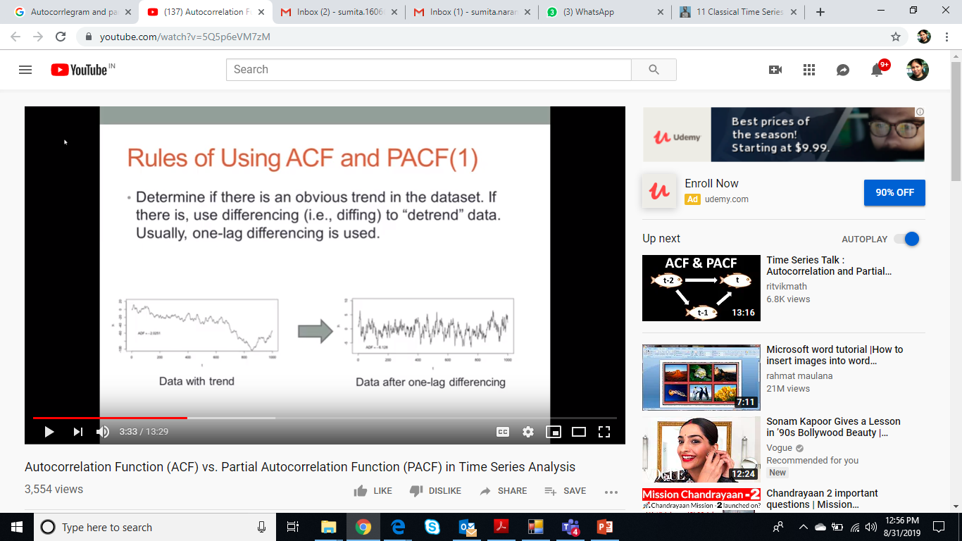
Seasonality analysis in TS Data 3/
Removing serial dependency. Serial dependency for a particular lag of k can be removed by differencing the series, that is converting each i'th element of the series into its difference from the (i-k)''th element. There are two major reasons for such transformations.
First, we can identify the hidden nature of seasonal dependencies in the series. Remember that, as mentioned in the previous paragraph, autocorrelations for consecutive lags are interdependent. Therefore, removing some of the autocorrelations will change other auto correlations, that is, it may eliminate them or it may make some other seasonalities more apparent.

Slide 39
Measure of Similarity – Time Series Data
Proximity is used to refer to either similarity or dissimilarity. Since the proximity between two objects is a function of the proximity between the corresponding attributes of the two objects, we first describe how to measure the proximity between objects having only one simple attribute, and then consider proximity measures for objects with multiple attributes.
This includes measures such as correlation and Euclidean distance, which are useful for dense data such as time series or two-dimensional points, as well as the Jaccard and cosine similarity measures, which are useful for sparse data like documents.
Note – T2, Ch 2, Section 2.4
Selecting right measure for proximity
Suppose, for example, that we are interested in comparing time series. If the magnitude of the time series is important (for example, each time series represent total sales of the same organization for a different year), then we could use Euclidean distance.
If the time series represent different quantities (for example, blood pressure and oxygen consumption), then we usually want to determine if the time series have the same shape, not the same magnitude. Correlation, which uses a built-in normalization that accounts for differences in magnitude and level, would be more appropriate.
In some cases, transformation or normalization of the data is important for obtaining a proper similarity measure since such transformations are not always present in proximity measures. For instance, time series may have trends or periodic patterns that significantly impact similarity. Also, a proper computation of similarity may require that time lags be taken into account.
Finally, two time series may only be similar over specific periods of time. For example, there is a strong relationship between temperature and the use of natural gas, but only during the heating season.

Slide 40
Finding Correlations – time series Data 1/2
This example illustrates an inconsistency in actual time series data that measures the sea surface temperature (SST) at various points on the ocean. SST data was originally collected using ocean-based measurements from ships or buoys, but more recently, satellites have been used to gather the data. To create a long-term data set, both sources of data must be used.
However, because the data comes from different sources, the two parts of the data are subtly different. This discrepancy is visually displayed in Figure 2.7, which shows the correlation of SST values between pairs of years. If a pair of years has a positive correlation, then the location corresponding to the pair of years is colored white; otherwise it is colored black. (Seasonal variations were removed from the data since, otherwise, all the years would be highly correlated.)
There is a distinct change in behavior where the data has been put together in 1983. Years within each of the two groups, 1958-1982 and 1983-1999, tend to have a positive correlation with one another, but a negative correlation with years in the other group. This does not mean that this data should not be used, only that the analyst should consider the potential impact of such discrepancies on the data mining analysis.

Slide 41
Finding correlations – time series data 2/2

Slide 42
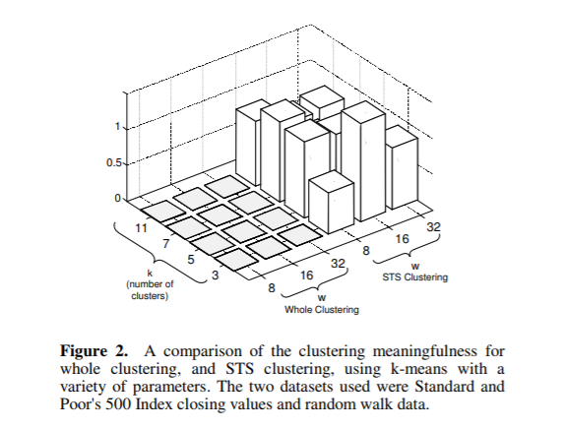
Time Series Data Clustering Techniques 1/
Clustering Time Series Data
https://towardsdatascience.com/dont-make-this-mistake-when-clustering-time-series-data-d9403f39bbb2
There are two types of clustering when dealing with time series data:
Whole clustering: When you have several time series which can come from different machines and want to compare them.
Subsequence clustering: When the original data is one long time series that needs to be broken into parts to do clustering on those parts.
This papers focuses on the second type of time series clustering, and makes the disruptive claim that clustering of time series subsequences is meaningless!
Notes:
The way to measure the “cluster meaningfulness” (z axis) is obtaining a value for the stability of the clusters (similar clusters for different runs with different initial centroids) and dividing it by the difference of the clusters obtain for the different datasets (one of them being random).
If this value is close to zero it means that the clusters are stable and far from the clusters generated for the random dataset. This clusters can be said to be meaningful. However, if this is close to one it means that the differences between different runs over the same data are similar to the differences with the clusters from the random dataset, this doesn’t make sense, since clusters generated from different datasets shouldn’t be similar; a value of 1 means that the clusters are not meaningful at all.

Slide 43
Time Series Data Clustering Techniques 2/
Time Series Data- Clustering techniques
(Refer T2, Ch 9, Section 9.12)
https://www.math.vu.nl/~sbhulai/papers/thesis-roelofsen.pdf
General clustering methods, such as k-means, are not designed for time series data and therefore may not perform well. This is mainly caused by the fact that most general clustering methods are built around the Euclidean distance, which does not seem to be a good measure for time series data.
So instead of Euclidean distance, compare seven different distance measures. An overview of the methods that we discuss can be found in Table 1. The seven distance measures can be divided into three different categories: lock-step, elastic and feature-based distance measures.

Slide 44
Feature Extraction – Time Series Data 1/2
How will you find patterns in Time Series data?
Technique is to map Time Series data to a different space/domain i.e. frequency domain. Feature Extraction using Fourier Transforms.
Many other sorts of transformations are also possible. Besides the Fourier transform, the wavelet transform has also proven very useful for time series and other types of data.
Consider, for example, time series data, which often contains periodic patterns. If there is only a single periodic pattern and not much noise' then the pattern is easily detected. If, on the other hand, there are a number of periodic patterns and a significant amount of noise is present, then these patterns are hard to detect. Such patterns can, nonetheless, often be detected by applying a Fourier transform to the time series in order to change to a representation in which frequency information is explicit.
Example 2.10 (Fourier Analysis). The time series presented in Figure 2.I2(b) is the sum of three other time series, two of which are shown in Figure 2.12(a) and have frequencies of 7 and 17 cycles per second, respectively. The third time series is random noise. Figure 2.12(c) shows the power spectrum that can be computed after applying a Fourier transform to the original time series. (Informally, the power spectrum is proportional to the square of each frequency attribute.) In spite of the noise, there are two peaks that correspond to the periods of the two original, non-noisy time series. Again, the main point is that better features can reveal important aspects of the data.
http://www.statsoft.com/Textbook/Time-Series-Analysis

Slide 45
Feature Extraction – Time Series Data 2/2

Slide 46
Exercise
Would the cosine measure be the appropriate similarity measure to use with K-means clustering for time series data? Why or why not? If not, what similarity measure would be more appropriate?
Notes:
Time series data is dense high-dimensional data, and thus, the cosine measure
would not be appropriate since the cosine measure is appropriate for sparse
data. If the magnitude of a time series is important, then Euclidean distance
would be appropriate. If only the shapes of the time series are important,
then correlation would be appropriate. Note that if the comparison of the
time series needs to take in account that one time series might lead or lag
another or only be related to another during specific time periods, then more
sophisticated approaches to modeling time series similarity must be used.

Slide 47
Forecasting Techniques
Time Series Data

Slide 48
Reference Videos
Overview of AR, MA, ARMA, ARIMA
https://www.youtube.com/watch?v=Aw77aMLj9uM
AR
https://www.youtube.com/watch?v=pFkCIg7pPjM
https://www.youtube.com/watch?v=6isJCv6pGY8
MA
https://www.youtube.com/watch?v=mC1ARrtkObc

Slide 49
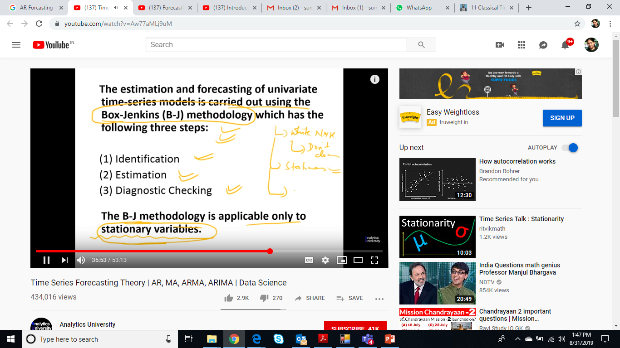

Slide 50
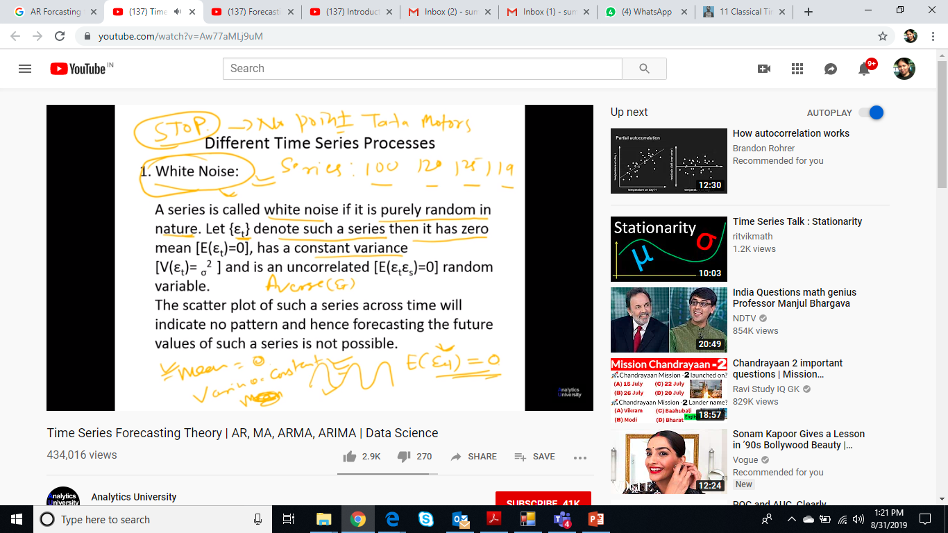

Slide 51
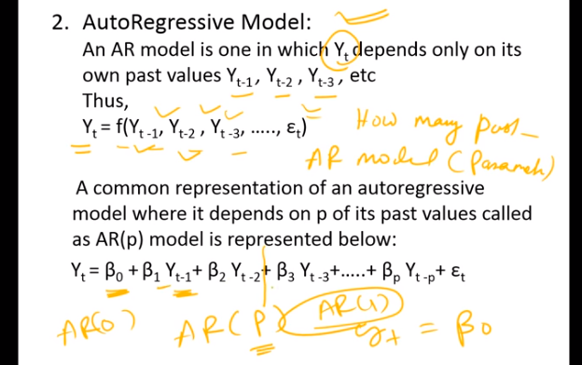

Slide 52
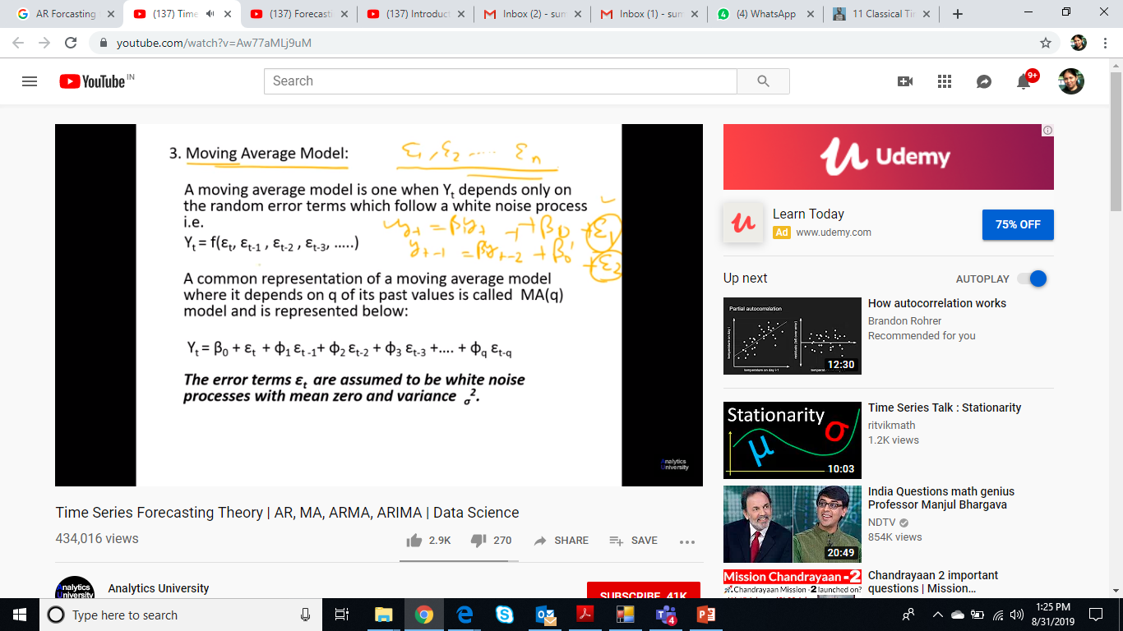

Slide 53
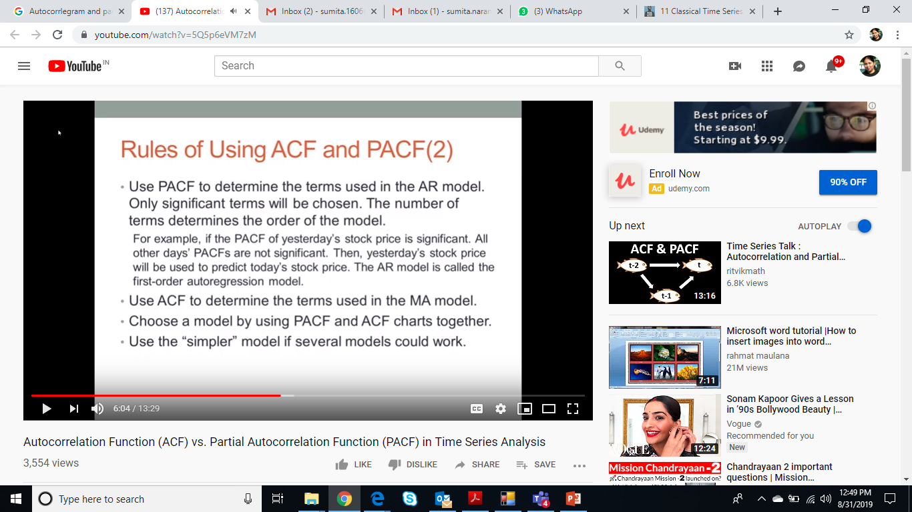

Slide 54
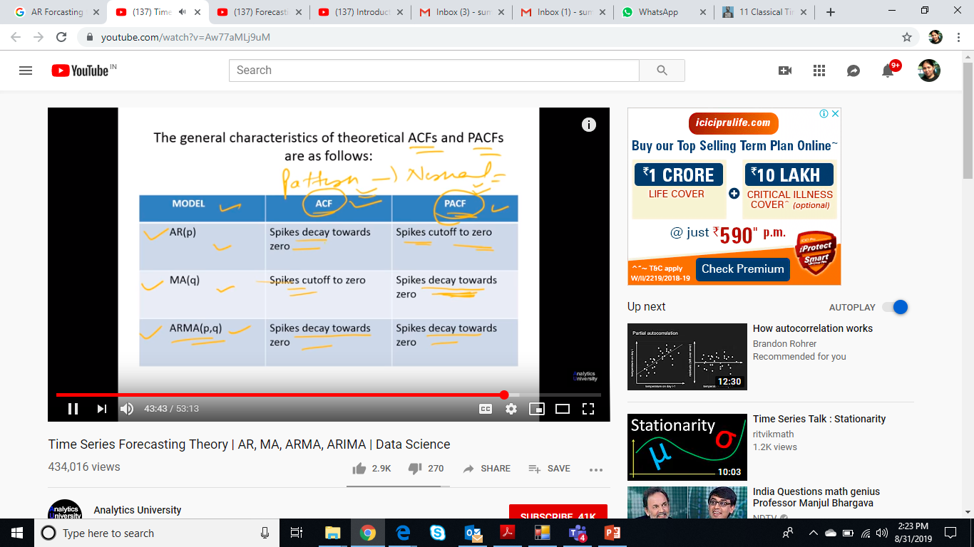

Slide 55
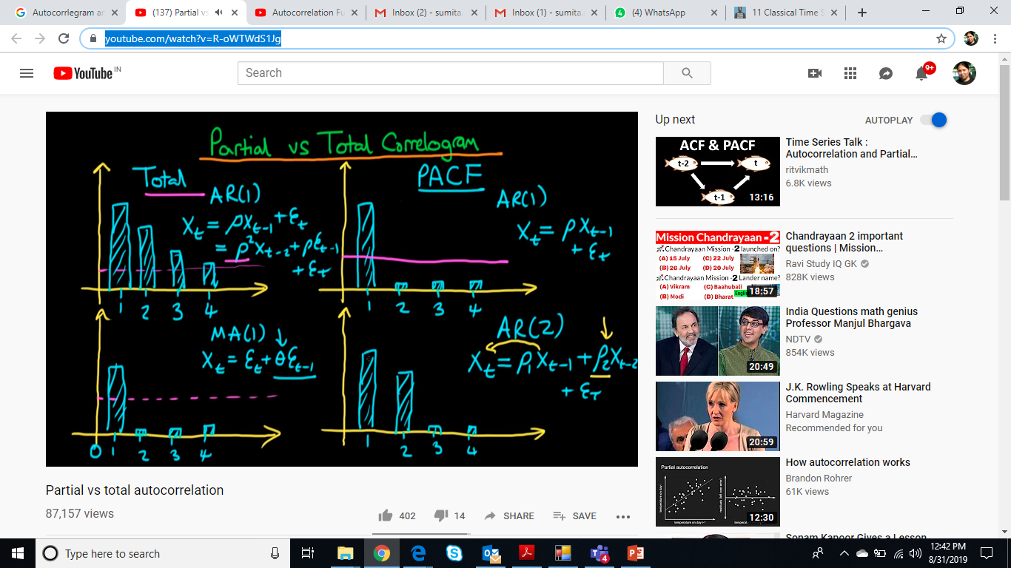

Slide 56
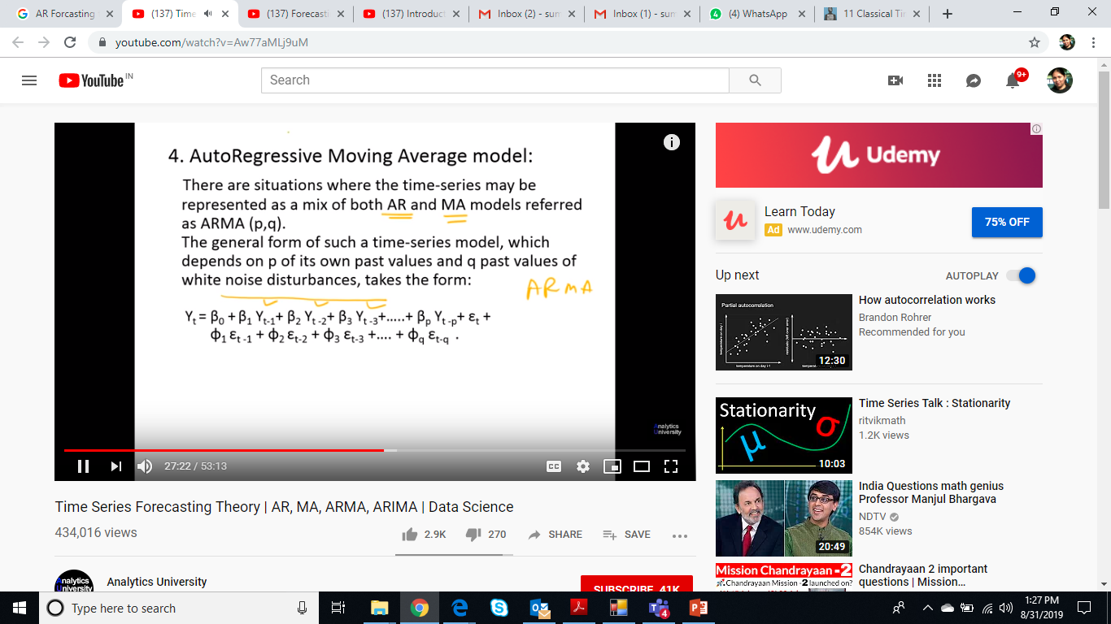

Slide 57
Time Series Forecasting Techniques 1/
https://machinelearningmastery.com/time-series-forecasting-methods-in-python-cheat-sheet/ (11 techniques discussed here)
Linear AutoRegression (AR) - The autoregression (AR) method models the next step in the sequence as a linear function of the observations at prior time steps. Lag =1, AR(1), Lag =2, AR(2) etc…
The method is suitable for univariate time series without trend and seasonal components.
Moving Average (MA) - The moving average (MA) method models the next step in the sequence as a linear function of the residual errors from a mean process at prior time steps.
The method is suitable for univariate time series without trend and seasonal components.
Autoregressive Moving Average (ARMA) -The Autoregressive Moving Average (ARMA) method models the next step in the sequence as a linear function of the observations and resiudal errors at prior time steps.It combines both Autoregression (AR) and Moving Average (MA) models.
The method is suitable for univariate time series without trend and seasonal components.

Slide 58
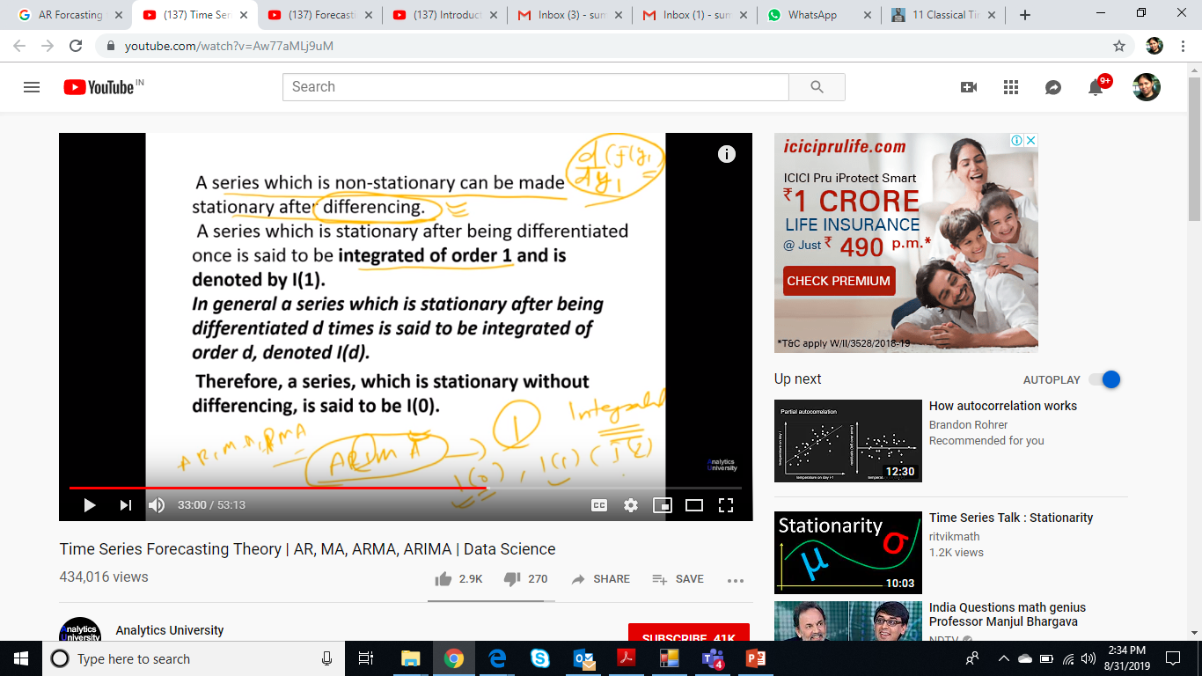
Non Stationary Time Series Data
Differentiate TS Data first to make it stationary
Then apply ARMA

Slide 59
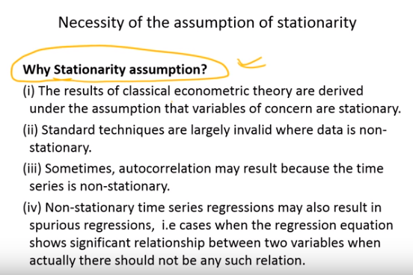

Slide 60
Time Series Forecasting Techniques 2/
4. Autoregressive Integrated Moving Average (ARIMA)
The Autoregressive Integrated Moving Average (ARIMA) method models the next step in the sequence as a linear function of the differenced observations and residual errors at prior time steps.
It combines both Autoregression (AR) and Moving Average (MA) models as well as a differencing pre-processing step of the sequence to make the sequence stationary, called integration (I).
This method is suitable for univariate time series with trend and without seasonal components.
5. Seasonal Autoregressive Integrated Moving-Average (SARIMA)
The Seasonal Autoregressive Integrated Moving Average (SARIMA) method models the next step in the sequence as a linear function of the differenced observations, errors, differenced seasonal observations, and seasonal errors at prior time steps.
It combines the ARIMA model with the ability to perform the same autoregression, differencing, and moving average modeling at the seasonal level.
The method is suitable for univariate time series with trend and/or seasonal components

Slide 61
Time Series Forecasting Techniques 3/
Seasonal Autoregressive Integrated Moving-Average with Exogenous Regressors (SARIMAX)
Vector Autoregression (VAR)
Vector Autoregression Moving-Average (VARMA)
Vector Autoregression Moving-Average with Exogenous Regressors (VARMAX)
Simple Exponential Smoothing (SES)
Holt Winter’s Exponential Smoothing (HWES)
Good Blog –
https://www.datascience.com/blog/time-series-forecasting-machine-learning-differences
https://www.analyticsvidhya.com/blog/2018/02/time-series-forecasting-methods/
https://www.analyticsvidhya.com/blog/2016/02/time-series-forecasting-codes-python/

Slide 63
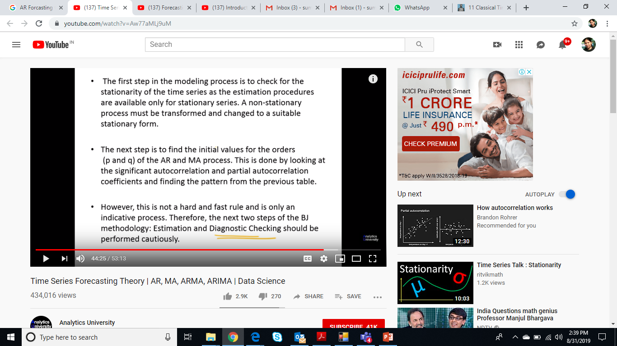
Identification(Time Series Data Analysis)
White Noise,
Trend, Seasonality, Stationarity
ACF, PACF
Estimation (Model Selection & Parameters)
ACF, PACF p and q values (lags)
Level of Integrated data (differentiation required for non stationary data) to convert it into stationary data

Slide 64
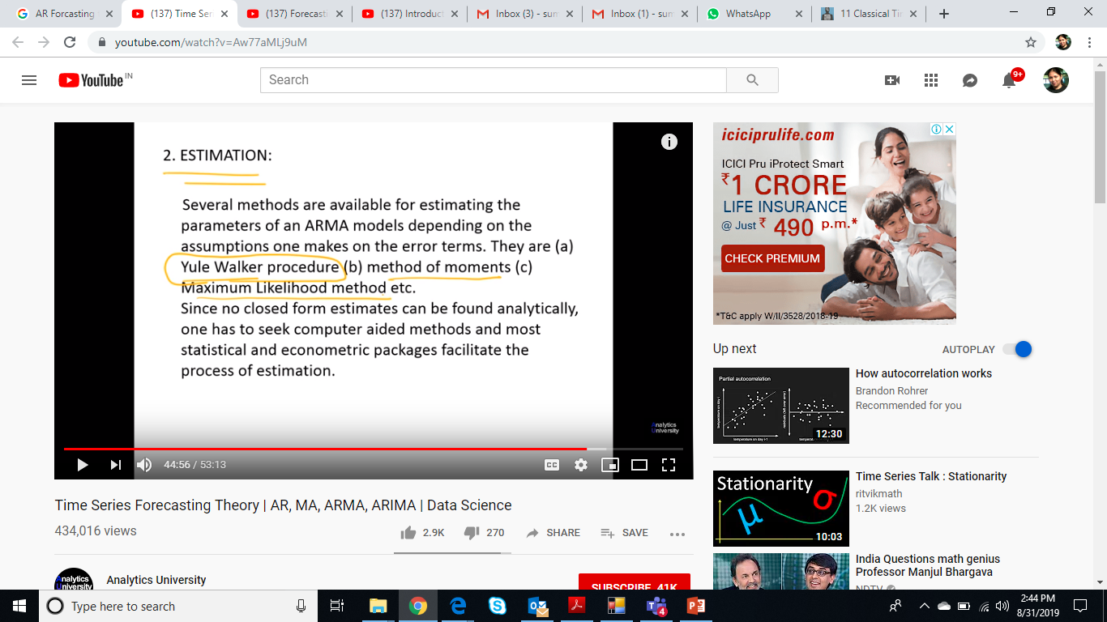

Slide 65
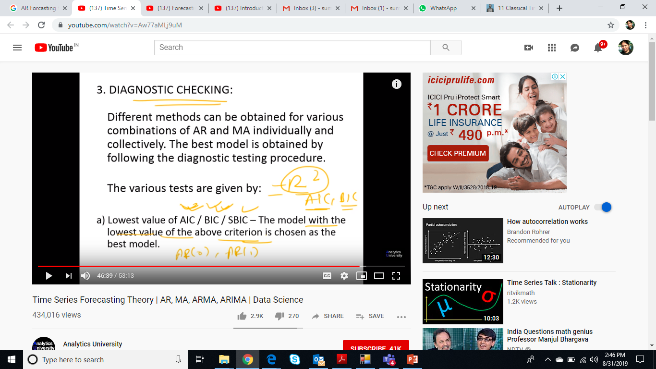
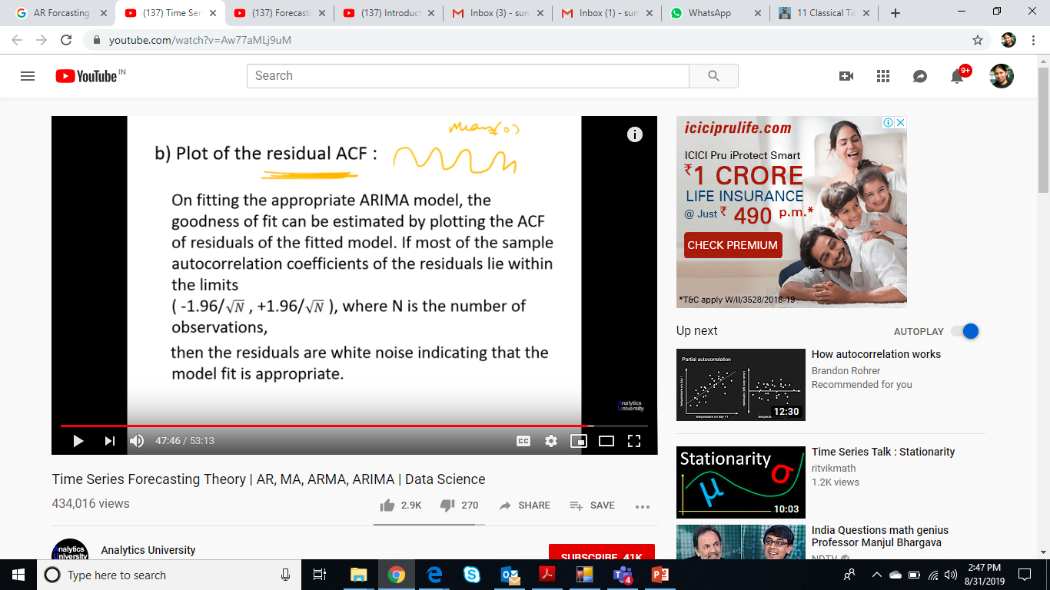

Slide 66
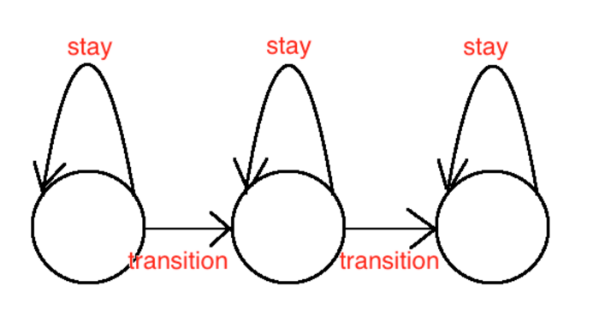
Hidden Markov for Time Series 1/
https://towardsdatascience.com/hidden-markov-models-for-time-series-classification-basic-overview-a59b74e5e65b
https://nwfsc-timeseries.github.io/atsa/Lectures/Week%206/lec_12_hmm.pdf
Markov Process
time may be discrete or continuous (we’ll focus on discrete)
Markov if at each time step, the state xt is only dependent on the previous state xt−1
xt does not depend on future values Entire history can be written as {x1, x2, x3, ..., xT }

Slide 67
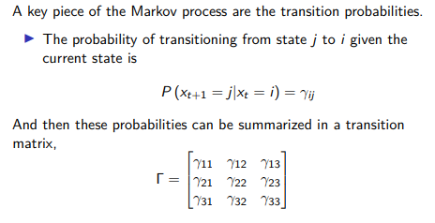
Hidden Markov for Time Series 2/
There are two general flavors of transition matrices:
Homogenous (or stationary): transition probabilities don’t depend on t
Non-homogeneous : transition probabilities are time-varying

Slide 68
Exercise
https://www.kaggle.com/mohitguptaomg/simple-forecast-with-ar-ma-arima/notebook

Slide 69
References
T2- introduction-to-data-mining-pang-ning
Ch 2, 6,7
https://blog.timescale.com/what-the-heck-is-time-series-data-and-why-do-i-need-a-time-series-database-dcf3b1b18563/
https://academy.datastax.com/resources/getting-started-time-series-data-modeling
http://www.statsoft.com/textbook/time-series-analysis
https://towardsdatascience.com/stationarity-in-time-series-analysis-90c94f27322
https://machinelearningmastery.com/decompose-time-series-data-trend-seasonality/
http://www.statsoft.com/textbook/time-series-analysis#1general

